Slide 1

Airline Safety
By Marc Riley

Slide 2
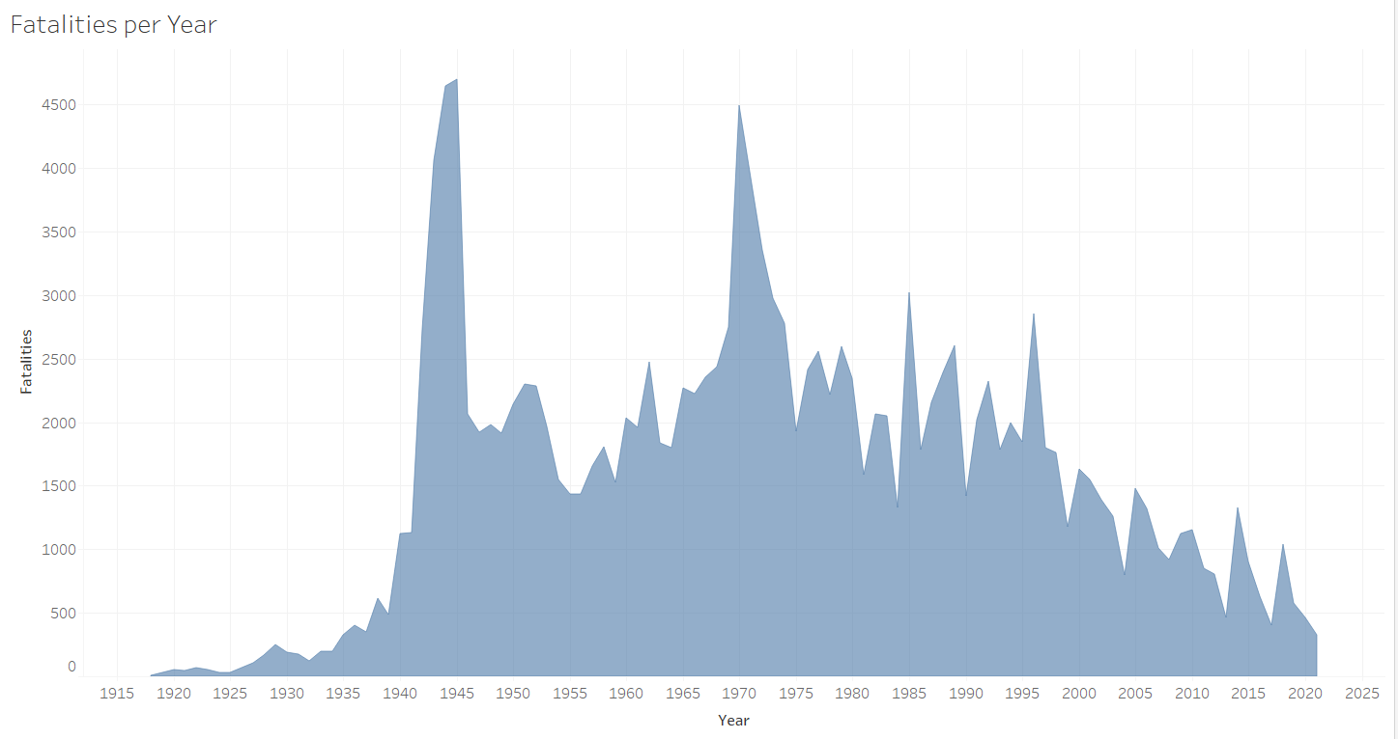
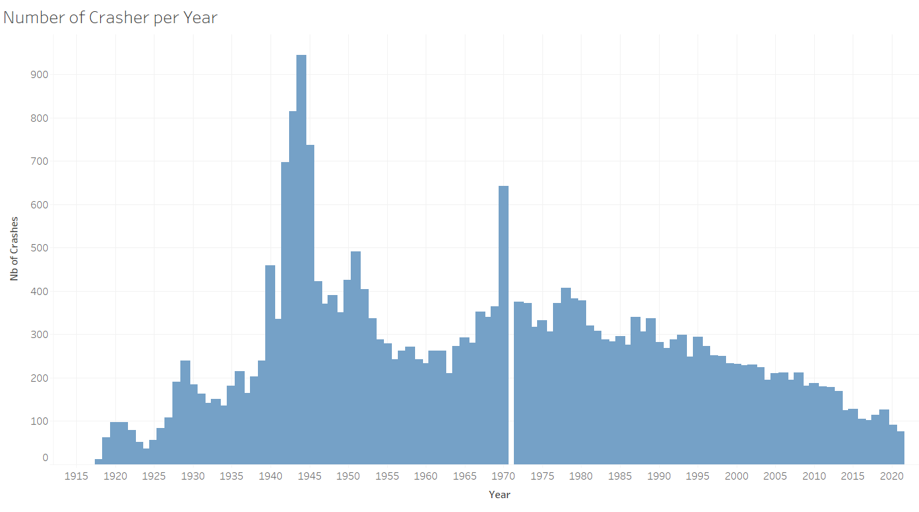
Is It Safe To Fly Today?
Fatalities Per Year
Crashes Per Year

Slide 3
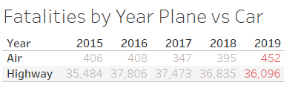
Plane vs Car
2019 Has been the worst year for Airline fatalities
Continue to make positive Improvements
Airline travel is still considerably safer than traveling by vehicle

Slide 4
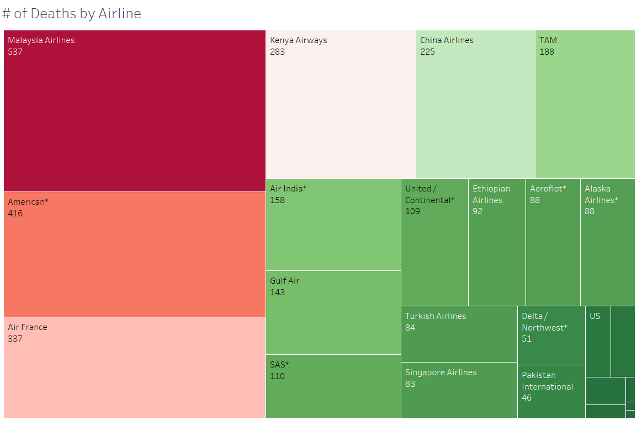
Deaths by Each Airline

Slide 5
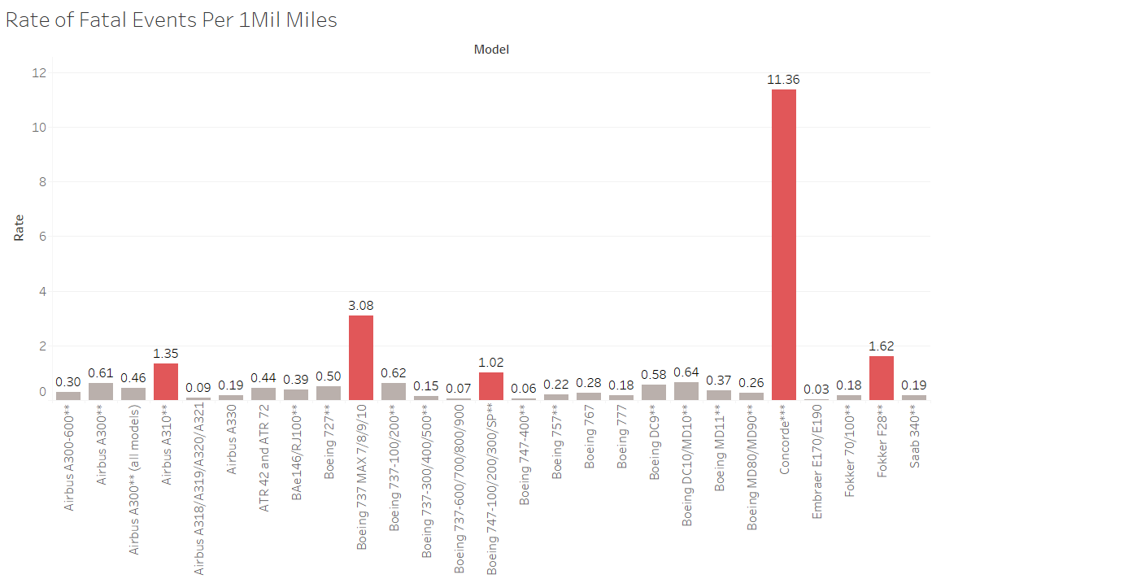
Rate of Fatal Events by Aircraft Type

Slide 6
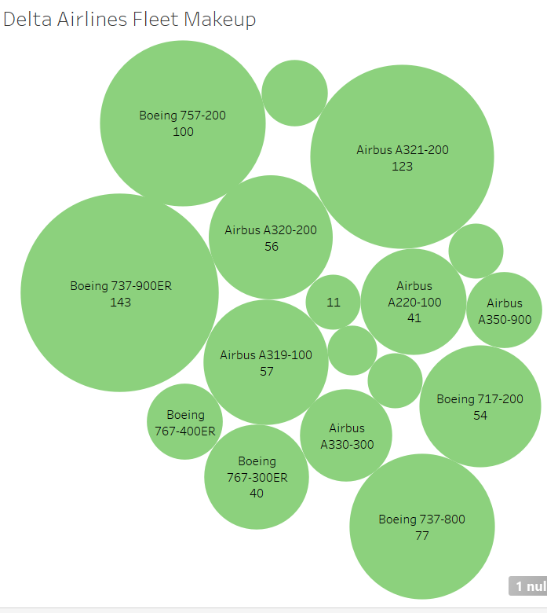
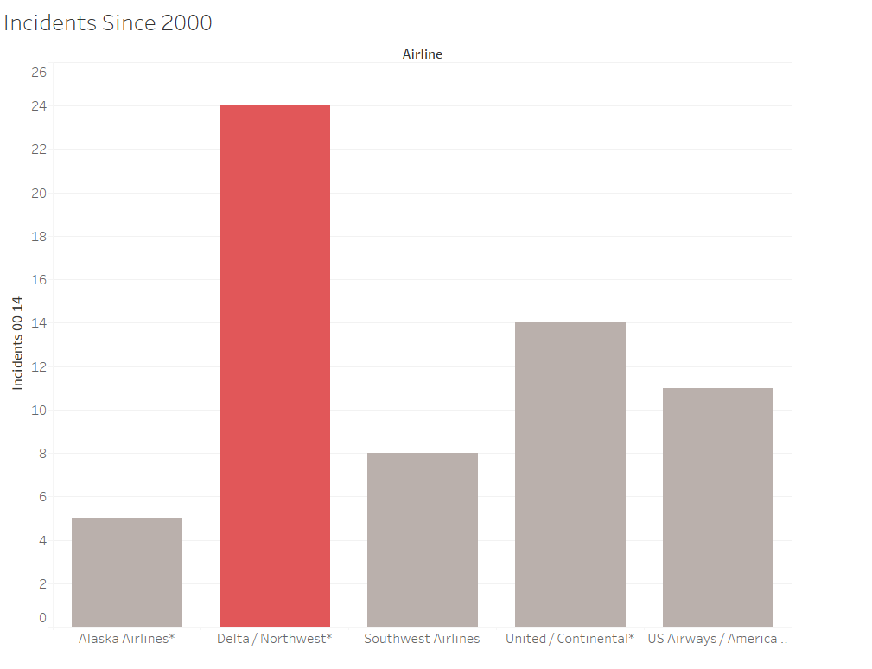
Fleet Make up/Incidents of Delta Airlines
Fleet Makeup
Incidents by Airline

Slide 7
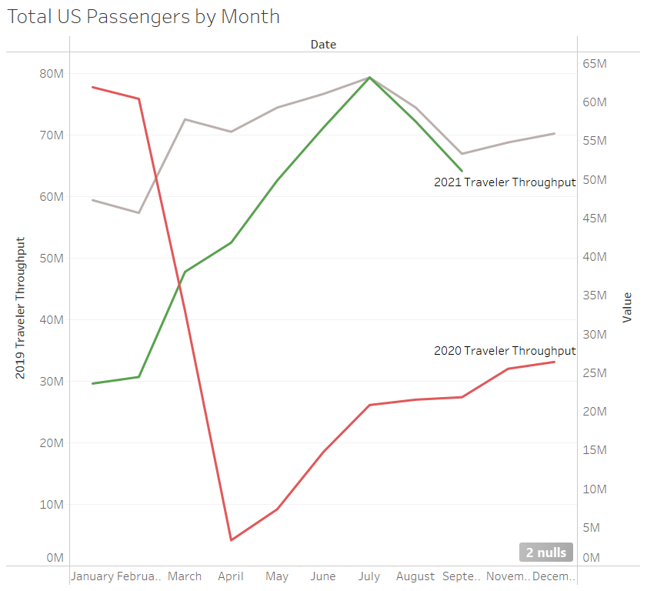

Future Passengers Expected

